Slide 1


Big Mart Sales Prediction

Slide 2
Agenda
Business Question
Predictive Analytics Steps
Statistics Results
Benefits
Q & A
EDIT IN POWERPOINT®
Click on the button under the presentation preview that says "Download as PowerPoint template". You will get a .pptx file that you can edit in PowerPoint.
Remember to download and install the fonts used in this presentation (you’ll find the links to the font files needed in the Presentation design slide)

Slide 3
Business Question
Historically, some products have outperformed other products of same category. As a business initiative, we are trying to unravel what has impacted and might impact product sales revenue.

Slide 4
Predictive Analytics Steps
Predictive Analytics
Define Project
Data Collection
Data Analysis
Statistics
Benefits
Feature Engineering

Slide 5

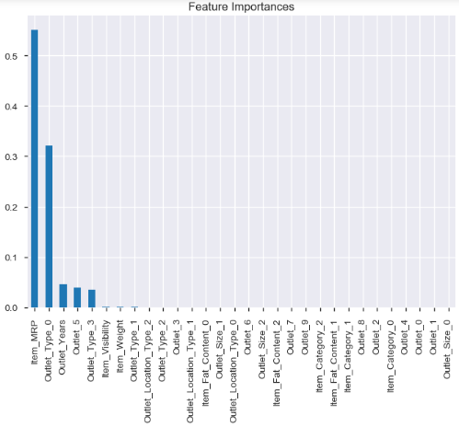
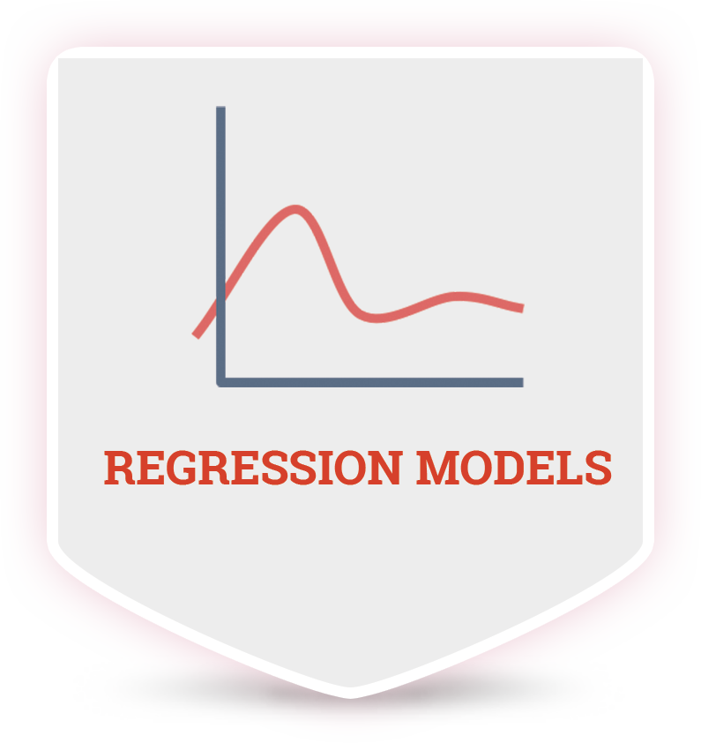
Statistics Results

Slide 6
Benefits
Conformed decision making
Targeted product placement
Marketing promotion strategy
Outlet strategy
Accurate revenue prediction
Revenue growth
Your audience will listen to you or read the content, but won’t do both.

Slide 7
Q & A

Slide 8

THANKS!
Any questions?
You can find me at
anirbanpal.wbut@gmail.com
apal@my365.Bellevue.edu

